Slide 1
Navigating within the File System Drive
Section 2

Slide 2
In this Section, we are going to take a look at…
Working with PSProviders and PSDrives
Exploring file system navigation and manipulation
Working with Registry keys
Identifying errors

Slide 3
Working with PSProviders and PSDrives

Slide 4
In this Video, we are going to take a look at…
PSProviders
PSDrives

Slide 5
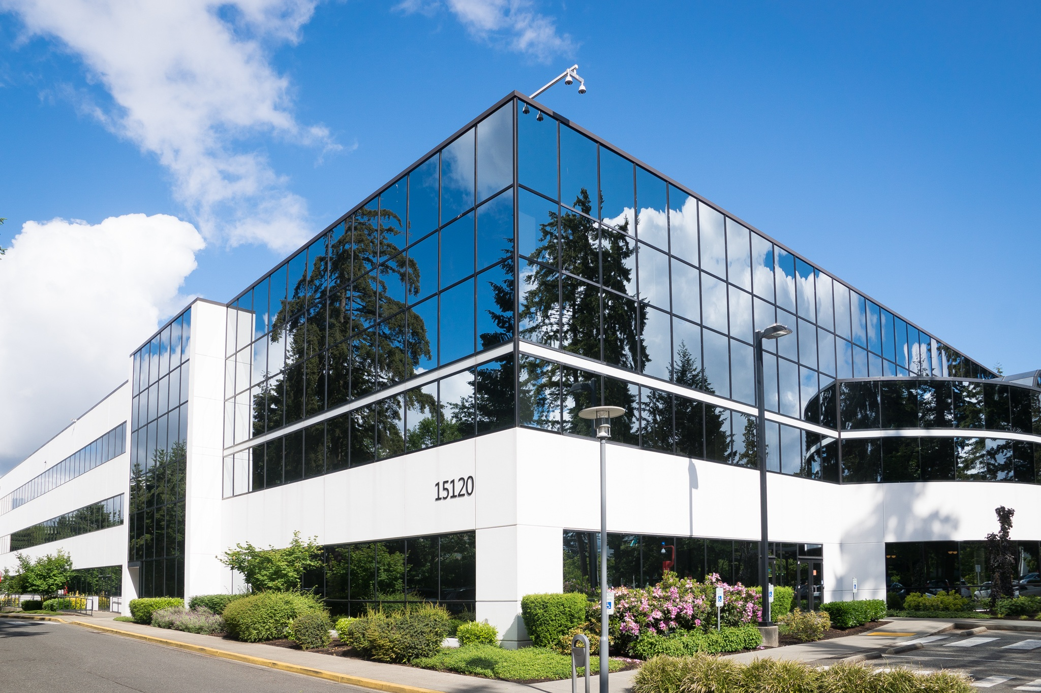
PSProviders
PSProviders define the logic that is used to access, navigate, and edit a data store

Slide 6

PSDrives
PSDrives specify an entry point to a data store

Slide 7
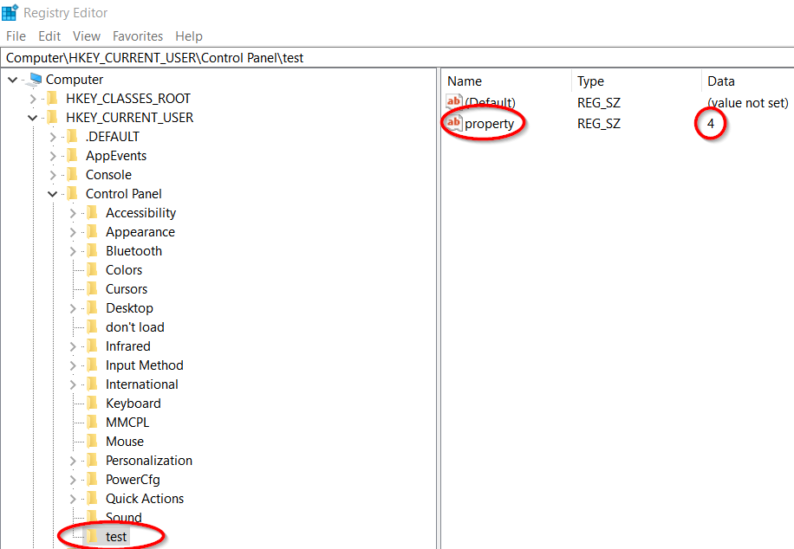
Registry Editor
Changes made in PowerShell while navigating the Registry may be seen in the standard Registry Editor as seen in our example

Slide 8
Exploring File System Navigation and Manipulation
Next Video

